Slide 1
Introduction to Clinical Psychology:
Science, Practice and Ethics
Introduction to clinical assessment
Assist. Prof. Merve Topcu
Department of Psychology, Çankaya University
2016-2017, Fall

Slide 2
Psychological assesment
Use of assessment for clinical purposes
Automatic decision making in daily life, but leads bias or type of errors
Psychological assessment is an iterative decision-making process in which data are systematically collected on the person (or persons), the person’s history, and the person’s physical, social, and cultural environments
Iteration ends, when assessement question is answered
All psychological assessments are undertaken to address specific goals
  E.g., reasons of an emotional rejection by an adolescence to plan a treatment
  E.g., cognitive abilities to encourage school performance

Slide 3
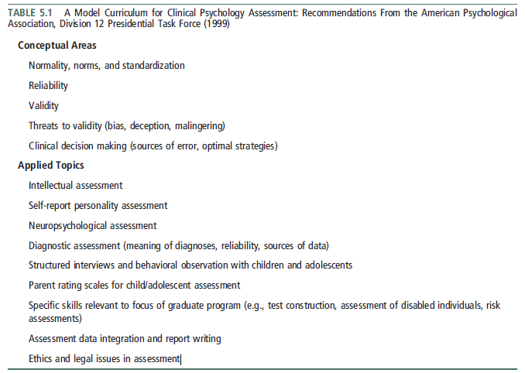

Slide 4
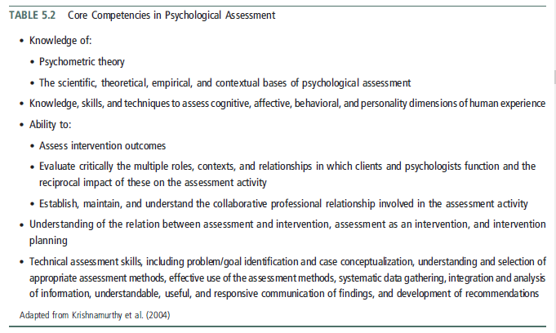

Slide 5
Aim of psychological assessment
Assessment-Focused Services
  initiated to answer basic questions about the person’s current functioning
  provide recommendations for remediation of problems
  provide an opinion on whether the person’s current level of functioning is substantially different from a prior level of functioning
    E.g., before a car accident or a work-related injury
  knowledge of the legal context in which their assessments will be used
    E.g., an insurance company or health management organization
Intervention-Focused Services
  the psychological assessment is not a stand-alone service
  a first step in providing an effective intervention

Slide 6
Screening
Psychologists are often called on to assist in the development or implementation of screening measures
Psychologists may or may not be directly involved in conducting screening asses
receiving the assessment as part of the routine operations of a clinic, school, hospital, or employment setting
The screening can be done online or in person at many community-based health care settings such as general hospitals, mental health clinics, and specialty health care providers’ offices

Slide 7
Diagnosis
Assessment data are used to formulate a clinical diagnosis
Interview data, psychological test data, and reports from significant others provide information on the symptoms
Knowing the diagnosis for a person helps clinicians communicate with other health professionals & search the scientific literature for information on associated features such as etiology and prognosis
Diagnosis can provide an initial framework for a treatment plan

Slide 8
Case formulation
Başvuru sebebi
Number of sessions - Görüşme sayısı
Supervisor - Süpervizör
Prognosis - Gidişat:
  Drop out / in progress
  Initial therapeutic aims
  Information about initial sessions
Genel bilgiler
  Demographics
Yaşantısal bilgiler
  E.g., Family, Social resources , etc.
Güçlü ve geliştirilebilir yönleri
Vaka formülasyonu
Görüşmelerin akışı
  Total görüşme sayısı
  Süreç / process
Hedefler
Terapistin kazanımları (optional)

Slide 9
Prognosis
Psychological assessment always implies some form of prediction about the patient’s future
Prognosis refers to the use of assessment data, in combination with relevant empirical literature, to make predictions about the future course of a patient’s psychological functioning
Ways to enhance the accuracy of predictions, weigh a number of factors such as time and cost, the consequences of inaccurate decisions, and the base rate of the predicted outcome
  Base rate, the frequency with which the problem / diagnosis occurs in the population
    the less frequently a problem occurs, the more likely a prediction error will occur

Slide 10
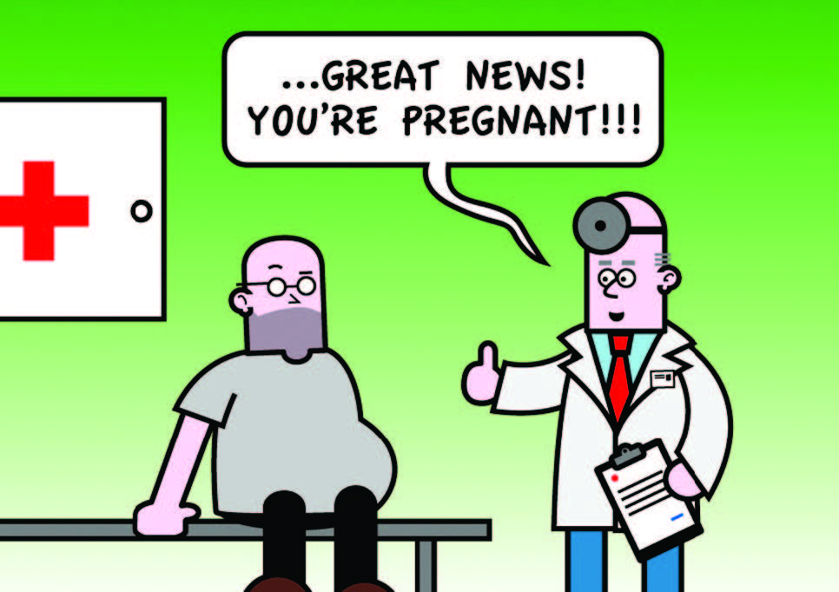
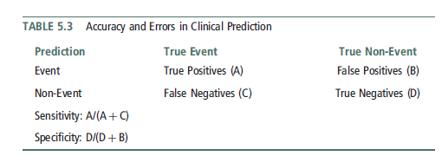
Prognosis
Errors in prediction
  True positive: the prediction that an event will occur was accurate
  True negative: the prediction of a non-event was accurate
  False positive: the prediction that an event will occur but, in fact, it does not occur
    Crying wolf
  False negative: An event occurs & prediction was wrong
    A guilty prisoner freed from jail
Type I Error: when the null hypothesis (H₀) is true, but is rejected
Type II Error: when the null hypothesis is false, but erroneously fails to be rejected

Slide 11
Treatment planing
The process by which information about the client (including sociodemographic and psychological characteristics, diagnoses, and life context) is used in combination with the scientific literature on psychotherapy to develop a proposed course of action that addresses the client’s needs and circumstances
Problem identification, treatment goals, and treatment strategies and tactics
  Case formulation
For treatment to be efficient and focused, goals must be specified
  Short-term goals & long term goals

Slide 12
Treatment monitoring & evaluation
Closely monitor the impact of treatment
Opportunity to reorient treatment efforts to avoid potential treatment failure

Slide 13
Psychological testing
The Standards for Educational and Psychological Testing (American Educational Research Association, American Psychological Association, & National Council on Measurement in Education, 1999)
  principles that psychologists must follow in developing and using tests and assessment procedures
Standart, ‘‘an evaluative device or procedure in which a sample of an examinee’s behavior in a specified domain is obtained and subsequently evaluated and scored using a standardized process’’
  Reliability, validity, norms
Psychological assessment & psychological testing are not synonymous

Slide 14
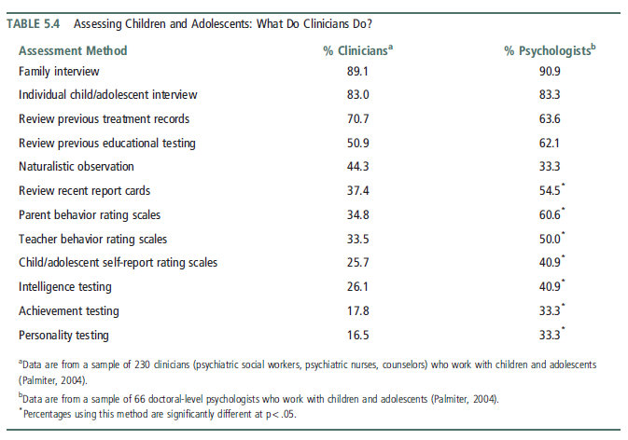

Slide 15
Psychometric considerations
Standardization
  To reduce variability in the testing situation, test developers provide detailed instructions regarding the nature of the stimuli, administrative procedures, time limits, and the types of verbal probes and permissible responses to the client’s questions
  It is essential that psychologists are trained in scoring the test and that they adhere to established scoring criteria
Reliability
  Internal consistency: whether all aspects of the test contribute in a meaningful way to the data obtained
  Test-retest reliability: if the person was retested at some point after the initial test
  Interrater / Interscorer reliability: whether similar results would be obtained if the test was conducted and/or scored by another evaluator
Validity
Norms

Slide 16
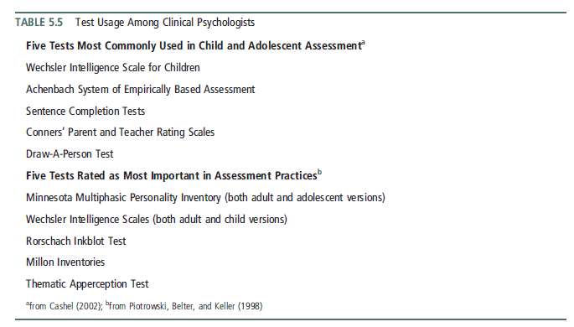
Testing practices
Türkçe Psikoloji Ölçüm Araçları Projesi

Slide 17
Evidence-Based Assessment
Evidence-based assessment (EBA) is an approach to psychological evaluation that uses research and theory to guide
  the selection of variables to be assessed for a specific assessment purpose,
  the methods and measures to be used in the assessment
  the manner in which the assessment process unfolds

Slide 18
Ethical considerations
Both the American Psychological Association (APA, 2002a) and the Association of State and Provincial Psychology Boards (ASPPB, 2005) have codes of conduct that contain elements specific to assessment activities
Informed consent!
  obtain freely given informed consent
Confidentiality
  All information collected as part of a psychological assessment must be treated as confidential
The distinction between test data and test material

Slide 19
Interviewing & Observation
To obtain information for case formulation, problem definition, and goal setting
Helps developing a collaborative relationship between client & psychologist
Psychologists are trained how to ask questions and how to listen
The oldest type of interview: mental status examination
  Covers patients’ thinking, speech, perceptions, mood, observation of appearance, & interpersonal relations
  Administiration is not in a standart way
  Widely used by psychiatrist

Slide 20
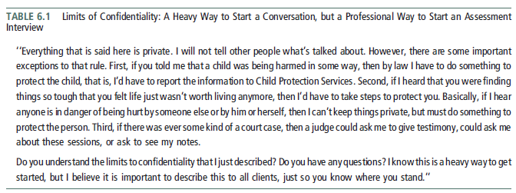
Interview
Informed consent!
  Explain the limits of confidentiality
clear signal that the conversation that will follow is a professional one
By explaining the limits of confidentiality, the psychologist demonstrates that in the context of psychological services, the client’s rights are protected, a person’s safety is considered paramount, and that it is possible to talk about very difficult issues.
Break confidentiality when a child or or an adult is at risk of being seriosly harmed

Slide 21
Unstructured interview
Create a safe environment
Free from disruptions
Offices are soundproofed to limit distracting background noises
Different from social conversation!
The psychologist is responsible for structuring the session to ensure that relevant topics are covered during assessment interviews
Theoretical orientation and training determine the extent to which he or she explicitly directs the session, the manner in which the questions are asked, and the topics that are covered

Slide 22
Unstructured interview
Facilitate the client’s engagement w/ open questions
Don’t worry about asking ‘difficult questions’
  Suicide, abuse, etc.
  use silence to allow the client time to reflect & not make them feel obliged to fill in the gaps in conversation as they might in a social context

Slide 23
Structured diagnostic interviews
To solve low inter-rater reliability problem, follow structured interviews
  Especially when diagnosis is essential
These interviews vary in their coverage of symptoms and life context
Structured Clinical Interview for Axis I Disorders (SCID)
  demographic information
  work history
  chief complaint
  history of present and past psychopathology
  treatment history
  assessment of current functioning
the Anxiety Disorders Interview Schedule for DSM-IV (ADIS IV)
the Primary Care Evaluation of Mental Disorders (PRIME-MD)

Slide 24
Interview w/ children
Use concrete forms
Not to use a sophisticated vocabulary
Use of muppets and/or drawings
Play
Consider different formats that vary in gender, age, ethnic background, and language
designed to explore the child’s perspective
differ from adults in terms of their attention span and capacity to stay focused on the interview

Slide 25
Attending skills
Listening skills
Attend carefully to what is being said and also observes nonverbal behavior
Use nonverbal behavior such as nods, eye contact, and vocalizations such as ‘‘Mmm . . .’’ and ‘‘Uh huh’’ to communicate that he or she is tracking the conversation without interrupting the flow of what is being said
Emotional reflections
  ‘‘it sounds as though that was very painful for you’’
focus exclusively on the client
not take turns in describing similar experiences that he or she has had!
  therapeutic self-disclosure is different than reciprocal sharing

Slide 26
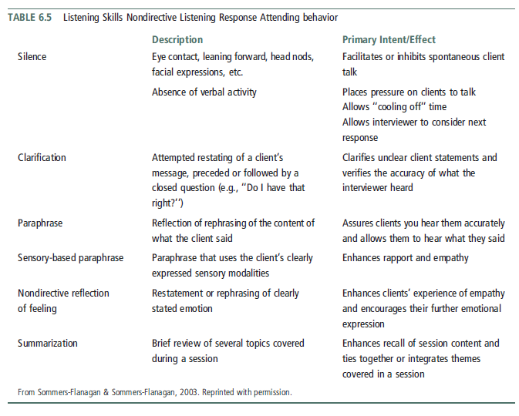

Slide 27
Attending skills
ask questions and listen to the client’s answers in a manner that is respectful and nonjudgmental
Be sensitive about ethnic background, socioeconomic, regional, and spiritual variables
  be aware of any cultural blind spots
  not assume that communication patterns and styles are universal
maintain a non-blaming stance and seek to understand the client’s perspective

Slide 28
Contextual information
The assessment interview is often used to gather contextual information
The type of background information considered essential to an assessment depends on the theoretical orientation of the psychologist
selectively focus on aspects that are most relevant for understanding the client’s problems
Focus on the personal resources that could be brought to bear on the problems

Slide 29
Defining problems & goals
have a clear sense of the patterns within the problem area
problem must be defined in specific & concrete terms
the psychologist must have a good understanding of normative behavior
Goal must be important to the client
Goal must be expressed in terms of the ways people behave
Goals must be small, simple, and achievable

Slide 30
Observations
the psychologist is a keen observer of the client
included comments on the client’s appearance and grooming
notice the client’s activity level, attention span, and impulsivity
Pay attention to the client’s speech, noting any difficulties or abnormalities

Slide 31
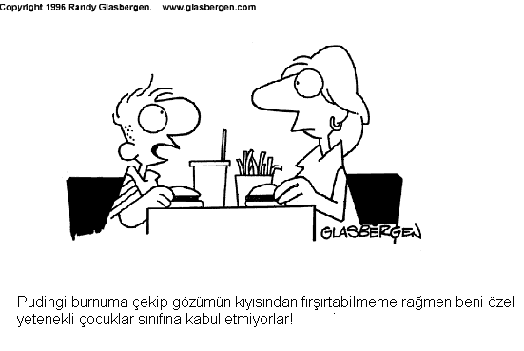
Intellectual & Cognitive Assessment

Slide 32
What is intelligence?
Important to define appropriately skill sets, areas of performance, & cultural contexts
Theories of intelligence
  Factor models
    two or more factors that are postulated to be at more or less the same structural level
  Hierarchical models
    there are different levels of factors, with the higher order or primary factors composed of lower order or secondary factors
  Information-processing models
    focus less on the organization of types of intelligence and more on identifying the processes and operations that reflect how information is handled by the brain

Slide 33
Theories of intelligence
Spearman (1927)
  All intellectual activities share a single common core known as the general factor
    G score
  However, bc measures of intellectual abilities are not perfectly correlated
    Specific factors, S score
    Two-factor model
Thurstone (1938)
  primary mental abilities, including spatial, perceptual, numerical, memory, verbal, word, reasoning, deduction, and induction abilities
  developed a measure of intelligence based on his model

Slide 34
Theories of intelligence
Cattell (1963)
  First hierarchical model of intelligence
  Cattell believed that existing intelligence tests were too focused on verbal, school-based tasks
  Two general factors in intelligence
    Fluid intelligence (Gf)
      The ability to solve problems without drawing on prior experiences or formal learning
      representing one’s innate intellectual potential
    Crystallized intelligence (Gc)
      what we have learned in life, both from formal education and general life experiences

Slide 35
Theories of intelligence
Sternberg (1985)
  In the 1980s, developments in cognitive psychology laid the groundwork for two influential information processing models of intelligence
  Postulated Triarchic Theory
    Three interrelated elements
      Componential
        The mental processes of planning, monitoring, and evaluating (referred to as executive functions)
        Performance, or the solving of a problem
        Knowledge acquisition, including encoding, combining, and comparing information
      Experiential
        The influence of task novelty or unfamiliarity on the process of problem solving
      Contextual
        Three different ways of interacting with the environment:
          Adaptation
          Alteration of the environment
          Selection of a different environment

Slide 36
Theories of intelligence
Gardner’s (1983, 1999)
  Theory of multiple intelligences
  Multiple forms of intelligence including
    Linguistic
    Musical
    Logical-mathematical
    Spatial
    Bodily-kinesthetic
    Intrapersonal
    Interpersonal
    Naturalist
    Spiritual
    Existential
    Moral
  Not surprisingly, given the early connection of intelligence tests to academic performance, these different types of intelligence are inadequately assessed by traditional tests

Slide 37
Assessing intelligence
Evaluation of intellectual functioning
  whether the current level of functioning represents a change from a previous level
  Premorbid IQ
    i.e., intellectual functioning prior to an accident or the onset of a neurological decline
  Progress has also been made in using demographic variables and scores for subtests of intelligence scales to predict premorbid IQ
  Intelligence tests
  Self-monitoring
  Data from relevant others

Slide 38
Assessing intelligence
There are three main Wechsler intelligence scales
  The Wechsler Adult Intelligence Scale–Fourth Edition (WAIS-IV)
    designed to assess individuals in the age range of 16 to 90 years
  The Wechsler Intelligence Scale for Children–Fourth Edition (WISC-IV)
    designed to assess children and adolescents in the 6–16 age range
  The Wechsler Preschool and Primary Scale of Intelligence–Third Edition (WPPSI-III)
    designed to assess children in the age range from 2 years 6 months to 7 years 3 months

Slide 39
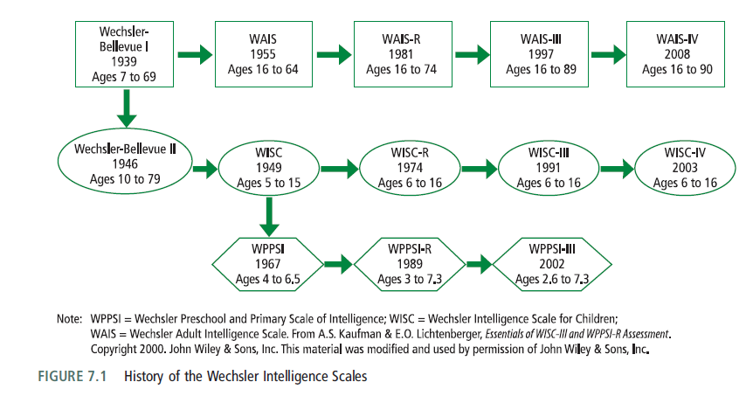
Assessing intelligence

Slide 40
Assessing intelligence
David Wechsler, developer of the Wechsler intelligence scales
  the use of deviation scores to measure intelligence (M = 100, SD = (±)15)
  IQ = (MA/CA) X 100
Mental abilities were tested by administering the Army Alpha test in a group format
  used to assess recruits who were unable to read or who had limited knowledge of English
The early versions of the WAIS, WISC, and WPPSI provided three main summary scores
  Verbal IQ (VIQ)
  Performance (nonverbal) IQ (PIQ),
  Full Scale IQ (FSIQ, the sum of Verbal and Performance scales)

Slide 41
Current Wechsler (WAIS–IV, WPPSI–IV) IQ classification
IQ Range ("deviation IQ") | IQ Classification
130 and above | Very Superior
120–129 | Superior
110–119 | High Average
90–109 | Average
80–89 | Low Average
70–79 | Borderline
69 and below | Extremely Low
Wechsler Intelligence Scale for Children–Fifth Edition (WISC-V) IQ classification
IQ Range ("deviation IQ") | IQ Classification
130 and above | Extremely High
120–129 | Very High
110–119 | High Average
90–109 | Average
80–89 | Low Average
70–79 | Very Low
69 and below | Extremely Low

Slide 42

Assessing intelligence in Turkish
2. Wechsler Intelligence Scale for Children - Revised (WISC-R)
  Wechsler çocuklar için zeka ölçeği
  1974 ilk orijinal yayın
  1995 Türkçe adaptasyonu
  6-16 yaş
  Sözel / performans / toplam zeka bölümü puanı
Tanı amaçlı değerlendirme
130 & üstü | Çok üstün
120 – 129 | Üstün
110 – 119 | Yüksek normal
90 – 109 | Normal
80 – 89 | Düşük normal
70 – 79 | Sınır zeka
70 & altı | Zihinsel engelli (z. e.)
50 – 70 | Hafif derecede z. e.
35 – 50 | Orta derecede z. e.
20 – 35 | Ağır derecede z. e.
20 & altı | Çok ağır derecede

Slide 43
Assessing intelligence
However recently, the four index scores for the adult tests (e.g.the WAIS-IV)
  Verbal Comprehension (the ability to comprehend and use verbal material)
  Perceptual Reasoning (the ability to use visually presented material)
  Working Memory (the ability to do timed tasks that require the use of information in short-term memory)
  Processing Speed (the ability to quickly process and use new information)
Implicitly, the Wechsler scales reflect a hierarchical model
  the separate abilities represented by the four index scores

Slide 44
Cognitive assessment
Usually need to supplement the results from an intelligence test with information obtained on other tests that address cognitive functioning
  In the book, said there are 2 commonly used tests
    the Wechsler Memory Scale–Third Edition
      a test that is typically used if there is a question of brain injury or brain dysfunction due to causes such as dementias, temporal lobe epilepsy, or Parkinson’s disease
    the Wechsler Individual Achievement Test–Second Edition
      a standardized achievement test
  But in Turkey frequent use ıf tests are changes!
    Bilnot Bataryası

Slide 45
Cognitive assessment
The Mini–Mental State Examination (MMSE)
  Mini-mental test
Bender Visual‐Motor Gestalt Test
  Bender-Gestalt Görsel Motor algı testi
    Ages between (5:06 – 10:11)
    Aims gaining information about intelligence, regression (psychopathological & personality effects, psychosis, simulation, organic brain damage)
Benton Visual Retention Test
  Benton Visual Retention Test
    Problems w/ reminding & recognizing visual stimuli
    Cerebral cortex functioning & academic achievement
    When w/out organic proof, gives information about individuals’ functioning despite hostility, apathy, paranoia, depressive symptoms & autistic preoccupation
      Normal < depressive < Demantia in terms of omission & size mistakes
      Normal < Schizophrenia in terms of distortion & perseveration mistakes
The visual aural digit span test
  Görsel işitsel sayı dizileri testi (GISD-B)
    Attention span & memory capacity
    Add PANAS, BAI & BDI when confused w/ anxiety

Slide 46
Assessment
Self-Report and Projective Measures

Slide 47
Personality Measures
Aim is to understand differences in personality and psychosocial functioning
Personality traits or dispositions
  a person’s tendency to consistently behave in a specific way
    E.g., ‘Describe yourself w/ 5 words?’
Personality theorists and researchers work to determine the influences of genetics and life experiences on the development and expression of traits
Most personality measures are based on self-report data
  are often called objective personality tests because they can be scored objectively
    i.e., the same scoring system is always used
Behavior checklists or symptom checklists are designed to provide information about the nature of an individual’s experience and the frequency or severity of the experience
  e.g., psychological distress, mood states, and feared situations
Projective personality tests

Slide 48
Personality Measures
The person–situation debate
  what if stability is illusory?
The clinical value of personality measures
The power of situational influences and those arguing for the power of personality were both correct
both situational characteristics and personality characteristics can enhance the prediction of human behavior

Slide 49
Personality Measures
Self-presentatıon biases
  deliberately underemphasized or overemphasized physical problems or emotional difficulties that you were experiencing
  Faking good / faking bad (malingering) / inconsistent or random responding
  Validity scales in personality tests
To avoid the problem of intentional misrepresentation, projective personality tests used bc of ambiguous nature of the test

Slide 50
Personality Measures
Personality measures must be relevant and unbiased across cultural and ethnic groups
  The test content may not be equally applicable or relevant to all cultural groups
  The pattern of validity coefficients may not be similar across groups
  The use of a cut-off score on a scale to classify individuals may not be equally accurate across groups
  Factor analysis
Subtle linguistic differences evident among these populations might affect the way in which respondents interpret test items

Slide 51
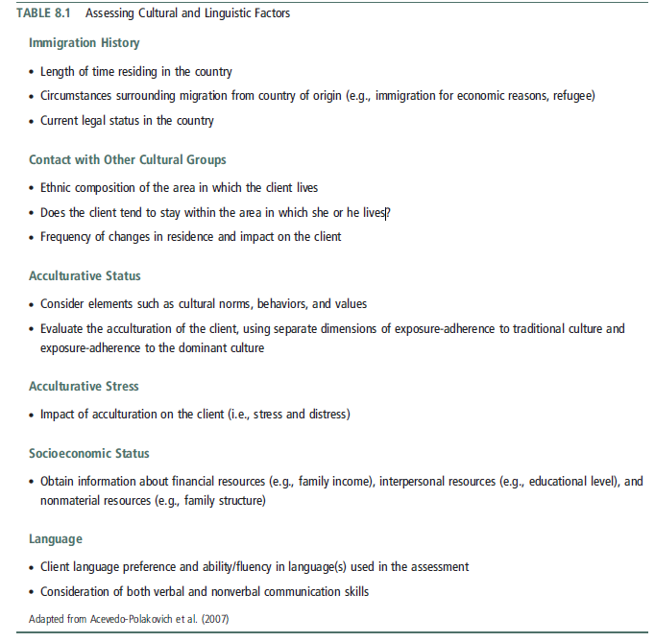

Slide 52
The clinical utility of self-report and projectıve measures
It is essential to distinguish between basic and applied perspectives
  1. Is the tool found to be useful by clinical practitioners?
  2. Is there replicated evidence that the measurement data provide reliable and valid information about clients’ psychological functioning?
  3. Does the use of the test and the resulting data improve upon typical clinical decision making and treatment outcome?

Slide 53
Self-report personality measures
the Minnesota Multiphasic Personality Inventory (MMPI)
  For adults (MMPI-2) & adolescents (MMPI-A)
  Keyed to DSM conditions, the Millon Clinical Multiaxial Inventory-III (for adults) and the Millon Adolescent Clinical Inventory (for adolescents)
  The Personality Assessment Inventory (PAI)

Slide 54
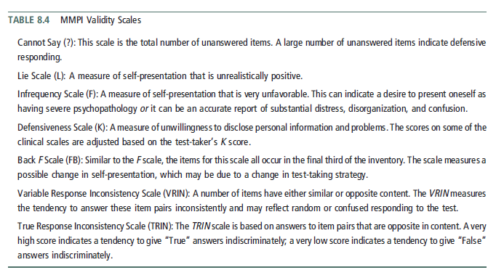

Slide 55
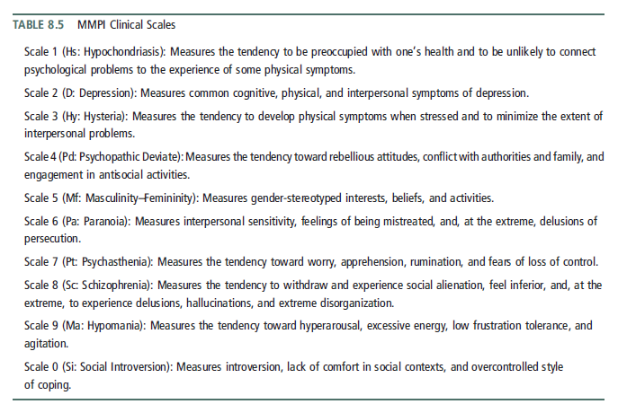

Slide 56
Self-report checklists of behaviors and symptoms
Shift away from reliance on time-consuming broad-band tests (such as personality inventories and projective measures) toward a greater use of self-report checklists of behaviors and symptoms
  the reimbursement practices of insurance companies and health care organizations
  Psychological assessments conducted as part of treatment provision
  Clinicians’ awareness of and demand for measures that aid in the formulation and evaluation of psychological services

Slide 57
Self-report checklists of behaviors and symptoms
Achenbach System of Empirically Based Assessment
Outcome Questionnaire 45
Beck Depression Inventory-II
Children’s Depression Inventory
The Symptom Checklist-90-Revised (SCL-90-R)
  90-item measure with 9 subscales
  Respondents are asked to indicate the extent to which they have been distressed by various symptoms over the past two weeks

Slide 58
Projective Assessment
the items or stimuli are ambiguous with respect to content and meaning
there is no inherent meaning to the stimulus material
there are no obvious right and wrong answers
Projection
  a type of defense mechanism in which people unconsciously attribute to others undesirable or negative parts of themselves
  Lack of standardization
Most projective tests used in clinical settings do not have standardized administration, scoring, or interpretation guidelines, and
only the Rorschach has normative data

Slide 59
Projective Assessment
Projective measures can be subdivided into five broad, but overlapping, categories
  Association techniques
    i.e., those requiring people to report what a stimulus looks like
    Rorschach Inkblot Test
  Construction techniques
    i.e., those requiring the individual to produce a story or a drawing
    Thematic Apperception Test
  Completion techniques
    e.g., sentence completion tasks
    Beier sentence completion test
  Arrangement/ selection techniques
    e.g., color tests that require the rank-ordering of preferred colors
  Expression techniques
    e.g., handwriting analysis

Slide 60
Projective Assessment
Rorschach Inkblot Test
  By Swiss psychiatrist Hermann Rorschach
  consist of 10 cards
  each contains symmetrical inkblots, some colored and some in black and white
  John Exner’s Comprehensive System (cs)
    the principal scoring system for the Rorschach
A major problem for the CS norms is the likelihood that non-patient norms overpathologize normal individuals
Interrater reliability values are debatable
Rorschach should not be used to provide diagnostic information

Slide 61

Rorschach Inkblot Test

Slide 62

Rorschach Inkblot Test

Slide 63
Projective Assessment
Thematic Apperception Test
  a projective measure composed of 31 cards
  asked to tell stories about pictures printed on cards
  in creating these stories, the dominant needs, emotions, and conflicts of the person’s personality are revealed
There is little consistency across clinicians and researchers in terms of
  how many cards are used in an assessment
  which cards are used, the order in which the cards are presented
  the instructions used in administering the test
  the scoring and interpretive principles used with the test

Slide 64
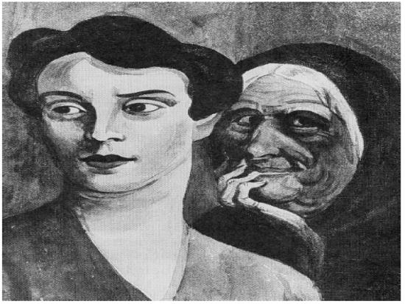
Thematic Apperception Test
Example

Slide 65
Children’s Apperception test (C.A.T.)
Individually administered projective personality test
Appropriate for children aged 3 to 10 years
Aim: measure the personality traits, attitudes, and psychodynamic processes
Originally developed to assess psychosexual conflicts related to certain stages of a child's development.
  E.g., relationship issues, sibling rivalry, and aggression.
Today, the CAT is more often used as an assessment technique in clinical evaluation.
(Frick, Barry, & Kamphaus, 2010)
Assumption: children would identify more readily with animals
(Reynolds, C. R., & Kamphaus, 2003)

Slide 66
Developmental & projective features
Consider developmental features of the children
  Two concepts
    Piaget’s “externalization”
    “Egocentrism”
(Reynolds, C. R., & Kamphaus, 2003)

Slide 67
Developmental & projective features
Piaget’s “externalization”
  a process by which we attribute to things in the external world the products of our own mental activity
  Elkind (1976) immediate & unconscious attribution that differs from “projection” in that it is a normal process common to everyone (thus, it is closer to “projection” as commonly used)
(Reynolds, C. R., & Kamphaus, 2003)

Slide 68
Developmental & projective features
“Egocentrism”
  young child’s inability to put himself or herself in another’s position and to adopt the other’s point of view.
  Kessler (1966)
    “the similarity between childlike egocentrism and the projection of the paranoid patient. Like that of the paranoid patient, the child’s narcissism is overwhelming. And like the paranoid individual, the children interprets the universe as revolving around him, either to hurt him or help him, and he personifies all happenings in terms of his own projected wishes and fears.”
(Reynolds, C. R., & Kamphaus, 2003)

Slide 69
Developmental & projective features
Other factors
  Language acquisition
  Childish way of communication
  Social desirability
  Motivation
  Degree of cooperation
Unlike the self-report measures of personality assessment used with adults, projective techniques do not depend on higher levels of language development and conceptual understanding.
(Reynolds, C. R., & Kamphaus, 2003)

Slide 70
Developmental & projective features
Progress from prelogical to logical though
  Freud (1911/1959) the developmental shift in terms of primary-process thinking vs. secondary-process thinking
  Primary process thinking can be seen in dreams, where anything is possible, often in defiance of the laws of logic.
  It dominates the thought processes of the young child.
  Primary-process thinking operates at the level of symbols.
  It is primitive and preverbal.
  Gradually, more of a child’s thinking processes come to be dominated by the reality principle, although lapses and regression are common, especially in times of emotional distress.
(Reynolds, C. R., & Kamphaus, 2003)

Slide 71
Developmental & projective features
Using magical thinking in the context of the adult real world leads to inevitable misunderstandings, frustrations, & conflict, often to the detriment of the child.
This difference in thinking can also play a key role in children’s emotional problems.
e. g., when a child, in appraising some event or situation, perceives the threat of harm or loss. If this perception results from magical thinking, it may well happen that an observing adult will see the child simply as being unrealistic (this is literally true, from the adult’s point of view).
(Reynolds, C. R., & Kamphaus, 2003)

Slide 72
“I have a number of pictures. I am going to show you one at a time. I want you to make up a story about each picture. Please tell me what is happening in the picture, what led up to this scene, and how the story ends. Tell me what the people are talking about and feeling. Use your imagination and remember that there are no right or wrong answers for the picture.”
(Frick, Barry, & Kamphaus, 2010)

Slide 73
Analysis
Clinical interpretation of a child’s story is typically based on two broad aspects of a child’s response.
  Process analysis
  Content analysis
(Frick, Barry, & Kamphaus, 2010)

Slide 74
Analysis (cont’d)
Process Analysis
  Note characteristics of the stories such as
    how elaborate the stories were,
    whether the stories were coherent and tied to the stimulus card,
    whether there were any specific cards for which the child had difficulty formulating a story.
  Used to determine how invested the child or adolescent was in the assessment process,
    whether there were any potential disturbances in thought processes,
    whether there were any specific types of stimuli that elicited defensive reactions from the child.
(Frick, Barry, & Kamphaus, 2010)

Slide 75
Analysis (cont’d)
Content Analysis
  Stories are typically analyzed for
    (1) the characteristics of the hero or main character
      e.g., motives, needs, emotions, self-image,
    (2) forces that affect the hero in his or her environment
      e.g., rejection by peers, punitiveness from parents, frightening forces, support by parent, affection from sibling,
    (3) the coping or problem solving strategies used by the hero
      e.g., aggression, compromise, nurturance,
    (4) the outcomes of the story
      e.g., positive or negative, outcomes brought about by hero or someone in his or environment, outcomes are realistic
(Frick, Barry, & Kamphaus, 2010)

Slide 76
Analysis (cont’d)
The content analysis should determine whether there are any consistent themes in a child’s story, especially themes that transcend the stimulus pull of a card.
  E.g., an aggressive story provided for a card that shows two children fighting is less diagnostic than a story with an aggressive theme based on a picture of two people sitting next to each other in a park.
(Frick, Barry, & Kamphaus, 2010)

Slide 77
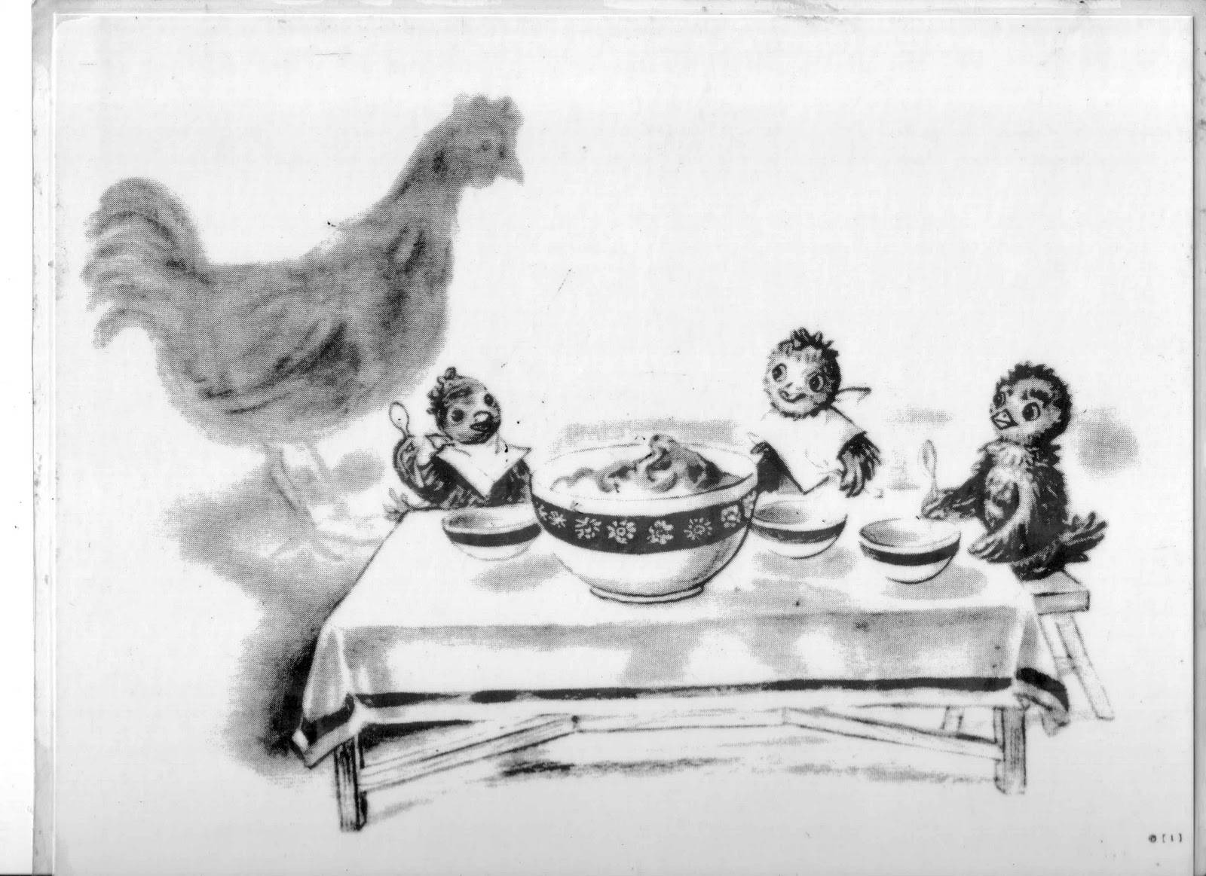
Children Apperception Test

Slide 78
Sentence Completion Test
A Form for Children (8-16)
  56 stimuli
B Form for Adults
  67 stimuli
Participants asked to complete sentences according to the stimulus
Beier cümle tamamlama testi A & B Formları

Slide 79
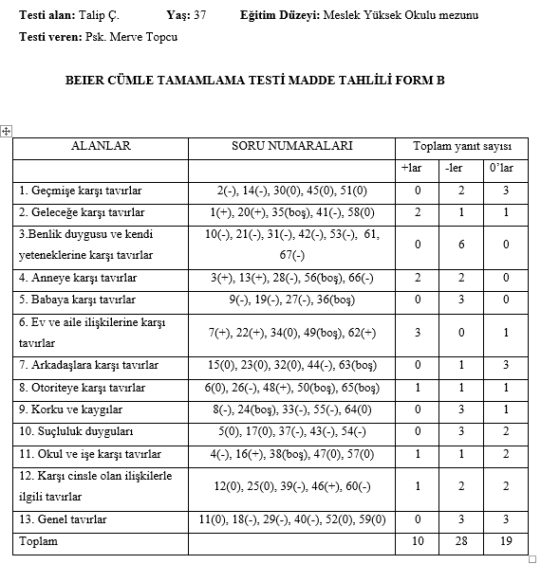
Sentence Completion Tests

Slide 80
References
Course book +
Frick, P. J., Barry, C. T., and Kamphaus, R. W. (2010). Clinical assessment of children and adolescent personality and behavior. New York: Springer.
Reynolds, C. R., and Kamphaus, R. W. (2003). Handbook of psychological and educational assessment of children: personality, behavior and context. New York: Guilford Press

Slide 81
Integration &
Clinical Decision Making

Slide 82
Integrating assessment data
The question as a framework to guide the process of drawing together the various pieces of information available about the client
  E.g., a client’s intellectual capabilities leads to the preparation of a report that highlights general intellectual functioning and more specific cognitive strengths and weaknesses.
Psychological assessment involves gathering and integrating multiple forms of information from multiple sources and perspectives

Slide 83
Integrating assessment data
Data obtained in psychological assessments only infrequently fit together smoothly and neatly
Rarely does one piece of information perfectly conform to a related piece of information.
Combining information from multiple psychological tests or even from multiple scales within a self-report personality test can be a daunting task.
Common practice begins by examining the client’s test responses at the most global level

Slide 84
Integrating assessment data
The purpose of the assessment is to provide directions for possible alleviation or remediation of problems.
  educational concerns
  vocational questions
  rehabilitation services
  possible referrals for psychotherapy
Psychologist needs to formulate hypotheses about how the problems developed and the factors that maintain them.
Psychologist provides recommendations of ways to improve the client’s functioning.

Slide 85
Integrating assessment data
Case Formulation
  describing the patient in his or her life context
  developing a set of hypotheses that pull together a comprehensive clinical picture in sufficient detail that the psychologist can make decisions about treatment options
Provides a way of understanding the connections between a patient’s various problems
Provides guidance on the type of treatment to consider (including whether the treatment should be conducted in an individual, couple, family, or group modality)
Predicts the patient’s future functioning if treatment is not sought and how this functioning will be different if treatment is successful
Provides options to consider if difficulties are encountered in implementing and following through on treatment
Indicates options, outside of psychological services, for the patient to consider
Provides alternative treatment options to consider if the initial treatment is unsuccessful

Slide 86
Case formulation
Başvuru sebebi
Number of sessions - Görüşme sayısı
Supervisor - Süpervizör
Prognosis - Gidişat:
  Drop out / in progress
  Initial therapeutic aims
  Information about initial sessions
Genel bilgiler
  Demographics
Yaşantısal bilgiler
  E.g., Family, Social resources , etc.
Güçlü ve geliştirilebilir yönleri
Vaka formülasyonu
Görüşmelerin akışı
  Total görüşme sayısı
  Süreç / process
Hedefler
Terapistin kazanımları (optional)

Slide 87
Integrating assessment data
Case formulation (from course book, p. 269)
  Four major components
    1. symptoms and problems
    2. Events or stressors that led to the symptoms and problems
    3. predisposing life events or stressors (i.e., preexisting vulnerabilities)
    4. A hypothesized mechanism that linked the first four components together to offer an explanation for the development and maintenance of the problems and symptoms.

Slide 88
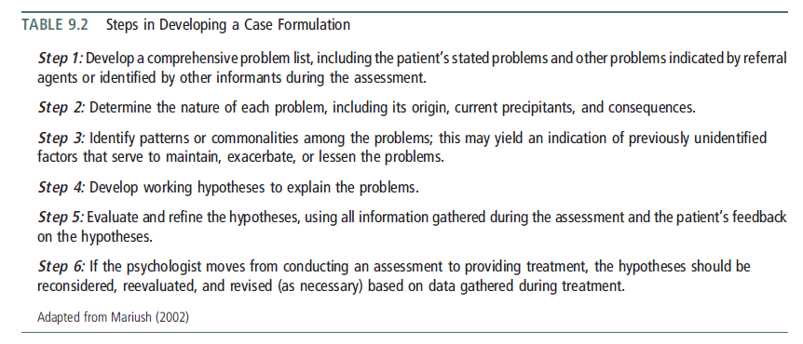
Integrating assessment data

Slide 89
Integrating assessment data
A major challenge is that the psychologist must accurately detect patterns in the wealth of data gathered during an assessment, including patterns that may be primarily attributable to cultural factors.
Theoretical orientation plays a central role in all aspects of the assessment process
  Succinct analysis of the client’s core strengths and weaknesses, premise.
  Supporting material, which involves an in-depth analysis of these strengths and weaknesses.
Eells, 2016 Psikoterapi Vaka Formülasyonu Litera Yayıncılık Türkiye

Slide 90
Threats to the validity of assessments & case formulations
Patient/Client Factors
  People may selectively choose how they depict themselves during a psychological evaluation
  Retrospective recall
  The desirability of the acts
  Memory effects on self-report measures compares people’s recording of events as they happen (or shortly after they happen) with their later recall of the events.
    E.g., low relationship satisfaction was significantly related to a tendency to recall the relationship events in an overly negative manner.
    Accuracy was very poor for recall of psychosocial variables
      E.g., the extent of conflict in the family prior to age 15
      E.g., the extent of depressive or hyperactive symptoms in participants prior to age 11

Slide 91
Threats to the validity of assessments & case formulations
Clinician Factors
  Experience, expectations, attributions, and stereotypes all shape the ways in which people make both relatively minor and major decisions.
  Self-serving attributional bias
    Making more internal, stable, and global attributions for positive events in their lives than they do for negative events
  Biases involve judgments that are systematically different from what a person should conclude based on logic or probability
  Heuristics are mental shortcuts that people often use to ease the burden of decision making but that also tend to result in errors in decision making
  People tend to be overconfident in the accuracy or correctness of their decisions

Slide 92
Common Decision-Making Biases &Heuristics
Fundamental Attribution Error: In attempting to understand why a person acted in such a manner, there is a tendency to overestimate the influence of personality traits and to underestimate the influence of situational effects on the person’s behavior.
Inattention to Base Rates: A psychologist may believe that a certain pattern of responses on a test is indicative of a specific diagnosis and supports this belief with information on some relevant cases. However, without full knowledge of the base rate of (a) the pattern of test responses and (b) the diagnosis, it is not possible to determine the extent to which the test responses accurately predict the diagnosis.
Belief in the Law of Small Numbers: Results drawn from small samples are likely to be more extreme and less consistent than those obtained from large samples. Nevertheless, the clinical psychologist may be tempted to attend more to information gained from two or three patients with a specific disorder than to the results of research on the disorder. Direct experience with a small number of patients may feel more relevant and compelling, even though it is less likely to yield accurate information compared with data drawn from research samples.
Regression to the Mean: Because of the nature of measurement error, a person who obtains an extreme score on a test at one point in time is likely to obtain a less extreme score when next taking the test. This apparent change in test scores has nothing to do with real alterations in the person’s life. (The standard error of measurement is available for many psychological tests so that psychologists can take this into account when comparing test scores from two time points.)

Slide 93
Common Decision-Making Biases &Heuristics
Inferring Causation From Correlation: A psychologist may note that there appears to be substantial co-occurrence of certain patient characteristics (such as a history of sexual abuse and the presence of borderline personality disorder) and infer that the earlier of the two characteristics causes the later characteristic (i.e., the abuse led to the development of the personality disorder). Before drawing causal inferences, though, other factors must be considered, including whether the later characteristic may influence the information provided about the earlier characteristic and the possibility that both characteristics stemmed from a third variable (e.g., severely dysfunctional family environment).
Hindsight Bias: As the saying goes, “Hindsight is 20/20.” Most decisions (including clinical decisions) must be made without the benefit of all the pertinent information. After a decision has been made and, as a consequence, a certain course of action has been taken, new information may become available. It is tempting to validate or question the initial decision based on data gathered after the fact even though it was not possible to have these data inform the original decision.
Confirmatory Bias: Once a clinical hunch has been formed, it is tempting to gather information to support it. However, in testing a hypothesis it is important to evaluate evidence both for and against the hypothesis. The clinical psychologist must avoid simply looking for evidence to support the hypothesis (such as a diagnosis or an emerging case formulation) and must also actively look for evidence that would refute or temper the strength of the hypothesis.

Slide 94
Common Decision-Making Biases &Heuristics
Representativeness Heuristic: Relying on biases such as the belief in the law of small numbers to draw conclusions about the degree to which a symptom or behavior is representative of an underlying disorder or condition.
Availability Heuristic: Making a decision based on easily recalled information, such as recent or extreme or unusual examples that are relevant to the decision. Using only easily recalled examples (such as the last person assessed with similar symptoms) will lead to an incomplete evaluation of the elements that must be considered in the decision; by definition, extreme examples are atypical and likely to bias a decision.
Affect Heuristic: When reaching a decision, the affective qualities (such as likeability, negativity, disgust, or pleasure) of cognitive representations of people or objects are rapidly considered. This usually occurs at an unconscious level and can lead to a judgment based solely on emotional considerations (such as the attractiveness of an individual), with only minimal attention paid to the full range of factors relevant to the decision.
Anchoring and Adjustment Heuristic: Initial conditions or characteristics determine a starting point for considering the nature of an individual or task (such as using the dealer’s price when negotiating to buy a car). In clinical contexts this means that, for example, first impressions may serve as the (possibly inaccurate) basis for considering and integrating all subsequent information gathered about a person.

Slide 95
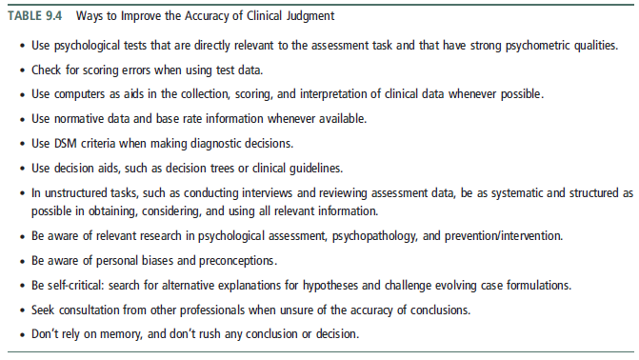
Improving the Accuracy of Clinical Judgement

Slide 96
Psychological assessment reports & treatment plans
the psychologist should write a report
  a document used for legal purposes
  be requested by many people including clients, the parents of young clients, physicians, insurance companies, employers, lawyers, or the courts
  privacy legislation allows clients access to their psychological record
Assessment Feedback

Slide 97
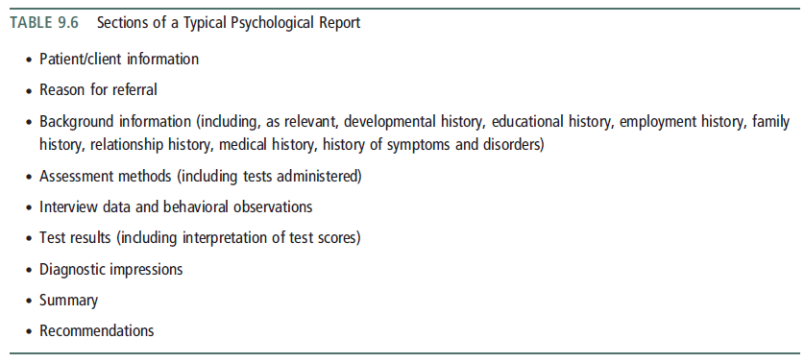
Psychological assessment reports & treatment plans

Slide 98
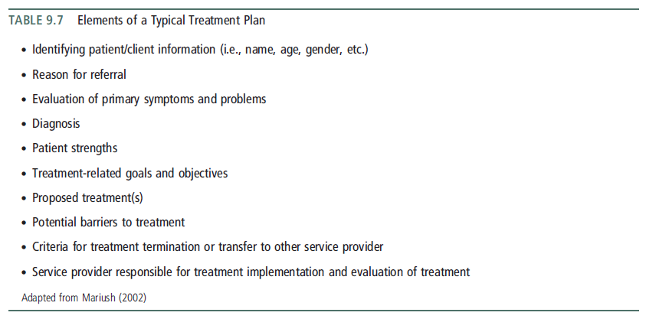
Psychological assessment reports & treatment plans

Slide 99
To be continued...

