Slide 1
Introduction to Clinical Psychology: Science, Practice and Ethics Prevention
Assist. Prof. Merve Topcu
PSY243, Department of Psychology, Çankaya University
2016-2017, Fall

Slide 2
Prevention in general
Prevention programs were first established to prevent physical health problems.
simple practices such as hand-washing, more intrusive procedures such as quarantining and wearing masks
challenging tasks such as the development and use of vaccines
Lifestyle factors are associated with many health problems
Many prevention efforts also focus on encouraging the development of healthy habits such as good nutrition, regular exercise, and adequate sleep.
Health promotion
increase activities that are beneficial to many aspects of physical health

Slide 3
Prevention in general
Community psychology, focuses on the reciprocal relations between individuals and the community in which they live
Health psychology
Prevention programs are often delivered by service providers who are not Clinical psychologists
the role of the clinical psychologist is more likely to be in program development, training, supervision, and evaluation than it is in front-line service provision
Prevention is based on the principle of early intervention
E.g.,
Promote effective parenting
Prevent various types of violence
Prevent internalizing disorders
Prevent substance abuse
Prevent problems in those exposed to trauma or loss

Slide 4
Approaches to prevention
The Commission on Chronic Illness (1957) identified 3 different types of intervention with respect to illness:
Primary
Primary intervention occurs before a disorder has developed and is designed to prevent the development of the disorder.
Secondary
When a disorder is evident; we usually refer to this type of intervention as treatment.
Tertiary
Intervention occurs with respect to a chronic disorder and focuses on rehabilitation and long-term adaptation
Both for mental & physical disorders

Slide 5
Prevention programs
Universal preventive interventions
applied to an entire population
E.g., Television advertising campaigns about flu, violence
Selective preventive interventions
target people who are at elevated risk of developing a particular disorder or problem
E.g., during an outbreak of a contagious disorder
Indicated preventive interventions
target people who do not meet criteria for a disorder but who have elevated risk and may show detectable but subclinical signs of the disorder
E.g., Those who have come into contact with a confirmed case of an infectious disorder

Slide 6
Prevention programs
Aims promoting health
Risk factors are characteristics of the individual or the environment that render a person more vulnerable to the development of a problem or disorder or that are associated with more severe symptoms.
Protective factors are those characteristics that protect high-risk individuals from developing the problem or disorder.

Slide 7
Risk Factors for the Development of Psychopathology in Children and Youth
Individual Factors
Complications in pregnancy and/or birth
Physical health problems or disability
Difficult temperament
Poor nutrition
Intellectual deficit or learning disability
Attachment problems
Poor social skills
Low self-esteem
Impulsivity
Attention deficits
School Context
Bullying
Peer rejection
Deviant peer group
Inadequate behavior management

Slide 8
Risk Factors for the Development of Psychopathology in Children and Youth
Family/Social Factors
Parental isolation
Single parent
Antisocial role models in family
Exposure to family or community violence
Harsh or inconsistent discipline
Inadequate supervision and monitoring
Parental abuse or neglect
Long-term parental unemployment
Criminality in family
Parental psychopathology

Slide 9
Risk Factors for the Development of Psychopathology in Children and Youth
Life Events and Situations
Abuse
Family disruption
Chronic illness or death of family member
Poverty
Unemployment
Homelessness
Parental imprisonment
War or natural disasters
Witnessing trauma
Migration
High-density living
Poor housing conditions
Isolated from support services including transport, shopping, recreational facilities

Slide 10
Risk Factors for the Development of Psychopathology in Children and Youth
Community and Cultural Factors
Socioeconomic disadvantage
Social or cultural discrimination
Isolation
Exposure to community violence or crime

Slide 11
Prevention
Carefully monitor its implementation to ensure that it is conducted as planned
The prevention program is likely to be implemented in numerous agencies that vary in their resources and staff skills.
Both the program’s short- and long-term outcomes must be monitored in order to fully evaluate its impact.
test whether there was a clinically significant reduction in their symptoms
determine whether or not they meet criteria for a diagnosis
Whether participants now score in the normal range on a particular measure

Slide 12
Protective Factors for the Development of Psychopathology in Children and Youth
Individual Factors
Easy temperament
Adequate nutrition
Positive attachment
Above-average intelligence
School achievement
Problem-solving skills
Social competence
Optimism
Positive self-esteem

Slide 13
Protective Factors for the Development of Psychopathology in Children and Youth
Family/Social Factors
Supportive, caring parents
Authoritative parenting
Family harmony
Supportive relationship with another adult (aside from parents)
Strong family norms and prosocial values
School Context
Prosocial peer group
Required responsibility and helpfulness
Opportunities for some success and recognition of achievement
School norms against violence
Positive school–home relations

Slide 14
Protective Factors for the Development of Psychopathology in Children and Youth
Life Events and Situations
Adequate income
Adequate housing
Community and Cultural Factors
Attachment to networks within the community
Participation in church or other community groups
Strong cultural identity and ethnic pride
Access to support services
Community/cultural norms against violence

Slide 15
Designing and Evaluating Prevention Research
Identify the target: What do you want to prevent?
Determine how serious the problem is. How many people are affected? What are the costs of the problem, in human suffering, health care costs, etc.?
Review the research evidence about the problem. What do we know about how the risk factors develop? What variables make it more likely that a problem will develop?
Identify high-risk groups. These are the factors that have been shown to moderate risk.
What is known about protective factors?
Design the intervention: How will the target condition be prevented? Is there an evidence-based prevention program for this problem? If so, does it need to be modified for my community?
Design the study: How will you know whether the intervention is efficacious?

Slide 16
Effectiveness
Controlled studies for effectiveness
Meta-analytic reviews of prevention programs are very useful in identifying the types of programs
Effectiveness refers to the extent to which a prevention program achieves desire outcomes when used in an applied setting rather than in the original research conditions.
It is important that the program be evaluated to determine its usefulness in each setting in which it is applied.

Slide 17
Promoting evidence-based parenting
Parents play a key role in their children’s socialization & development of child & adolescent psychopathology
Three evidence-based programs that have been developed to promote good parenting
Home Visiting Programs
Triple P
Incredible Years

Slide 18
Promoting evidence-based parenting
Home Visiting Programs
program offering services to low-income teenage single mothers expecting their first child
Home visits were conducted by trained nurses beginning during the pregnancy and continuing after the child’s birth.
taught skills in both self-care and child care and promoted women’s use of the health care system
benefits for children in terms of reducing child abuse and neglect
reducing the number of arrests, convictions, substance abuse problems, and sexual promiscuity in the children when they reached the age of 15

Slide 19
Promoting evidence-based parenting
Triple P, Positive Parenting Program
(a) enhance knowledge, skills, and confidence of parents
(b) promote safe environments for young people
(c) promote children’s competence through positive parenting practices
a multilevel system that provides interventions of gradually increasing intensity, according to the level of need

Slide 20
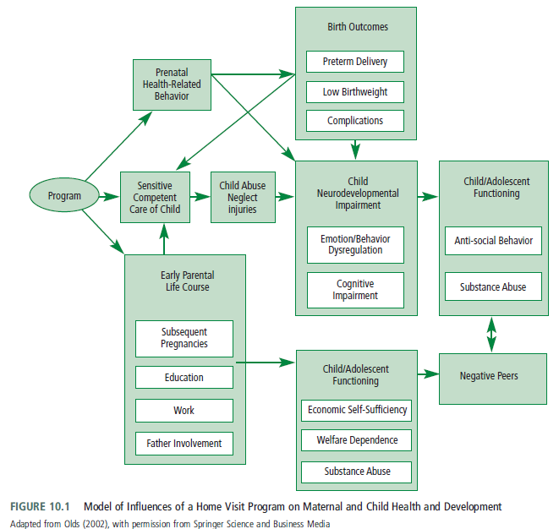
Promoting evidence-based parenting
http://www.triplep.net/glo-en/home/

Slide 21
Promoting evidence-based parenting
Incredible Years training program
originally designed to help children ages 3–8 who had been identified as having conduct problems
train parents in skills
effectively play with their child
provide praise for positive behaviors
set limits on unacceptable behaviors using time-out, ignoring, appropriate consequences
problem solving
An advanced 9- to 12-session program targets parents. interpersonal difficulties by teaching problem solving, anger management, communication, emotional regulation skills, and support-seeking skills.

Slide 22
Prevention of violence
Physical Abuse of Children
The deliberate infliction of injury on a child
Home visiting programs, behavioral parent training programs, and multimodal programs were effective in modifying the risk of physical abuse
Behavioral training and stress management
Improvements in parenting skills were evident in the short-term only and were not maintained at follow-up

Slide 23
Prevention of violence
Youth Violence: Bullying & Delinquency
Common reasons due to problems with aggressive and noncompliant behavior
Young people are very resistant to efforts to change their behavior
Therefore, more sense to try to prevent its development in the first place
There is some overlap between the types of programs designed to prevent violence and delinquency and those designed to treat oppositional defiant disorder and conduct disorder in young children.

Slide 24
Prevention of violence
Youth Violence: Bullying & Delinquency (cont’d)
Home visits, Triple P, and Incredible Years
School-based interventions
Directly target aggression and violence by training students in anger management and conflict resolution
Aims improvements in prosocial behaviors
Teachers are the key agent of change
Their recognition of a problem with bullying
Their commitment to the program are essential to its effective implementation

Slide 25
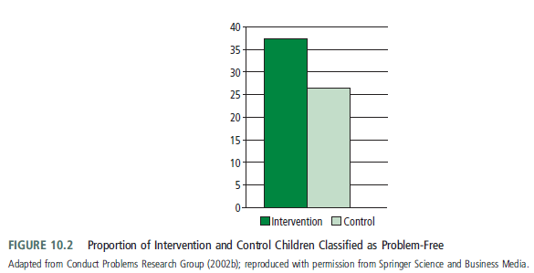
Prevention of violence
Youth Violence: Bullying & Delinquency (cont’d)
The Fast Track Project (1990)
A multiyear program
based on available research on risk and protective factors in the development of conduct disorder
Program was designed to assess the feasibility of
engaging community stakeholders in the project
maintaining the program’s fidelity while responding to local needs
maintaining community engagement so that the program would be sustainable
The intervention included a child component designed to increase academic competence, emotion regulation, and social skills
Discipline, support of constructive behavior, and monitoring of activities were targeted in the parent component.
Group discussions were followed up by
home visits
The classroom component involved a curriculum
designed to promote self-control, emotional
awareness, and social problem solving.
37% less likely to have serious problems than
were children in the control group

Slide 26
Prevention of violence
Youth Violence: Bullying & Delinquency (cont’d)
Although the total elimination of disorders or illnesses would be ideal, prevention programs usually have a more realistic goal of reducing the incidence of disorders.
37% less likely to have serious problems than were children in the control group
High-risk children who participated in the program had better social competence, fewer problems in social cognition, less involvement with deviant peers, and fewer conduct problems than did high-risk children who did not participate

Slide 27
Prevention of internalizing disorders
The person with internalizing problems may suffer quietly on his or her own without coming to anyone’s attention.
Anxiety
Risk factors for the development of anxiety
Inhibited temperament
Avoidant coping style
Overprotective parenting practices
Parental anxiety

Slide 28
Prevention of internalizing disorders
Paula Barrett developed a prevention program that was adapted from an effective treatment program for children with anxiety disorders
School children were screened to identify those with mild to moderate anxiety problems who were randomly assigned to an intervention group or to a monitoring group.
the Coping Koala program
10 sessions w/ children
3 sessions w/ parents
followed by booster sessions
At 12-month follow-up, differences between the intervention group and the comparison group had diminished
by the 24-month follow-up, 39% of children in the untreated group met criteria for an anxiety disorder, whereas only 20% of children in the intervention group did so
Participation in the program was associated with almost a 50% reduction in the incidence of anxiety disorders at 2-year follow-up.

Slide 29
Prevention of internalizing disorders
Barrett and Turner (2001) adapted the Coping Koala program to a format that could be used in a universal prevention program delivered by teachers
«Friends for Children and Friends for Youth»
Longer-term follow-up evaluations and replications in other cultures are under way

Slide 30
Prevention of internalizing disorders
Risk factors for the development of depression
Interpersonal skills deficits
Cognitive errors
Parental depression
Marital conflict
Negative life events
Studies with a greater percentage of female participants had larger effect sizes
For interventions, it is recommended including a focus on at-risk groups
Being a female adolescent
Offspring of depressed parents
Being exposed to family-related stress such as divorce
Bereavement

Slide 31
Prevention of internalizing disorders
Preventive interventions reduce the incidence of depressive disorders by 22%.
Programs based on cognitive-behavioral and interpersonal principles are promising strategies
School-based programs offer an appealing avenue to circumvent adolescents avoidance of the stigma of mental health services.

Slide 32
Prevention of substance abuse
Alcohol, tobacco, and drug use during pregnancy are associated with a host of deleterious consequences
Premature delivery
Low birth weight
Perinatal mortality
Long-term neurological and cognitive-emotional problems
Tobacco is responsible for 4.1% & alcohol is for 4.0% of the total global economic costs due to disability
(World Health Organization, 2004)
Substance abuse is a leading cause of adolescent morbidity and mortality due to its links with motor vehicle accidents and with sexual behavior leading to unplanned pregnancies and HIV infection

Slide 33
Prevention of substance abuse
Individual-level risks
Temperamental factors
Coping skills
Psychopathology
Exposure to negative life events
2 types of programs in general
Interactive
foster the development of interpersonal skills
Yielded more effect size
Noninteractive
lecture-based
Efficacy was associated with active parental involvement in developing social competence and self-regulation.

Slide 34
Son ...

